Slide 1


Alfonso Mondragón Montero
13 June 2022

Slide 2

Outline
Executive Summary
Introduction
Methodology
Results
Conclusion
Appendix

Slide 3
Executive Summary
Summary of methodologies
Data Collection through API
Data Collection with Web Scraping
Data Wrangling
Exploratory Data Analysis with SQL
Exploratory Data Analysis with Data Visualization
Interactive Visual Analytics with Folium
Machine Learning Prediction
Summary of all results
Exploratory Data Analysis result
Interactive analytics in screenshots
Predictive Analytics result

Slide 4
Introduction
Project background and context
Space X advertises Falcon 9 rocket launches on its website with a cost of 62 million dollars; other providers cost upward of 165 million dollars each, much of the savings is because Space X can reuse the first stage. Therefore, if we can determine if the first stage will land, we can determine the cost of a launch. This information can be used if an alternate company wants to bid against space X for a rocket launch. This goal of the project is to create a machine learning pipeline to predict if the first stage will land successfully.
Problems you want to find answers
What factors determine if the rocket will land successfully?
What features determine the success rate of a successful landing?

Slide 5

Section 1

Slide 6
Methodology
Executive Summary
Data collection methodology:
Data was collected using SpaceX API and web scraping from Wikipedia
Perform data wrangling
One-hot encoding was applied to categorical features
Perform exploratory data analysis (EDA) using visualization and SQL
Perform interactive visual analytics using Folium and Plotly Dash
Perform predictive analysis using classification models
How to build, tune, evaluate classification models

Slide 7
Data Collection
The data was collected:
Using get request to the Space API
Then, I decoded the response content as a Json using .json() function call and turn it into a pandas dataframe using .json_normalize().
I filter the dataframe to only include Falcon 9 launches.
I dealt with missing values
The goal was to extract the launch records as HTML table, parse the table and convert it to a pandas dataframe for future analysis

Slide 8
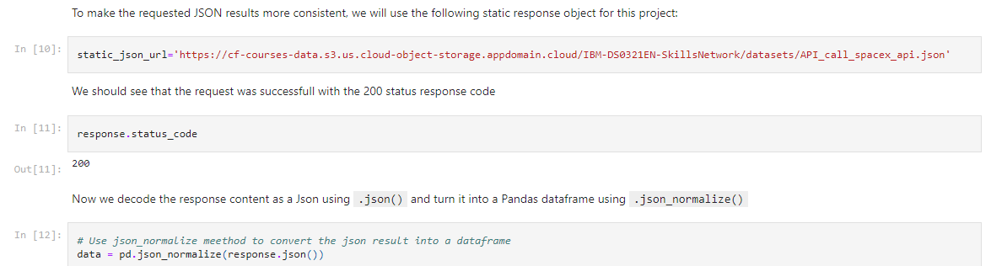
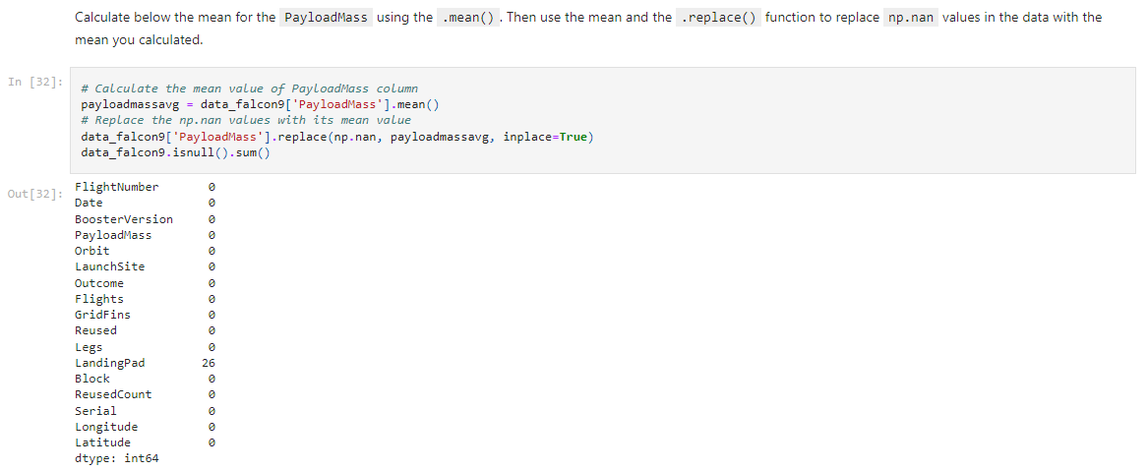
Data Collection – SpaceX API
I used the get request to the SpaceX API to collect data, clean the requested data and did some basic data wrangling and formatting.
The link to the notebook is https://github.com/amm2307/Capstone_Project/blob/master/Capstone%20Final%20Project%20IBM%20Machine%20Learning.ipynb
Place your flowchart of SpaceX API calls here

Slide 9
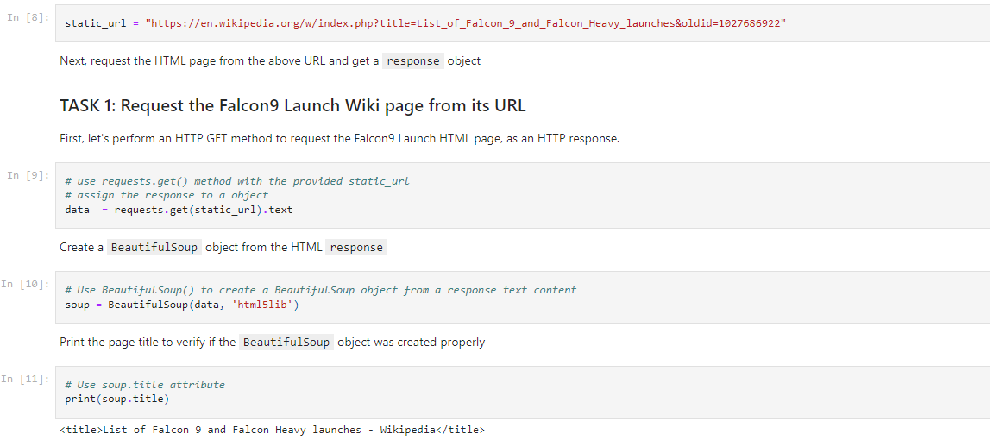
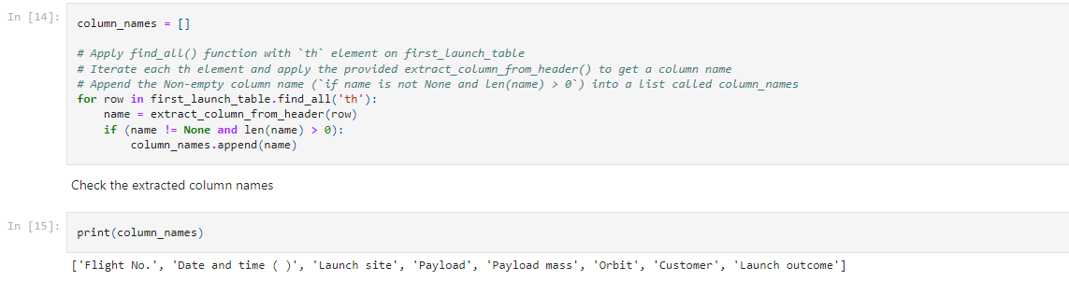
Data Collection - Scraping
I applied web scrapping to webscrap Falcon 9 launch records with BeautifulSoup, and I parsed the table and converted it into a pandas dataframe.
The link to the notebook is https://github.com/amm2307/Capstone_Project/blob/master/Hands-on%20Lab%20Web%20Scraping.ipynb
Place your flowchart of web scraping here

Slide 10
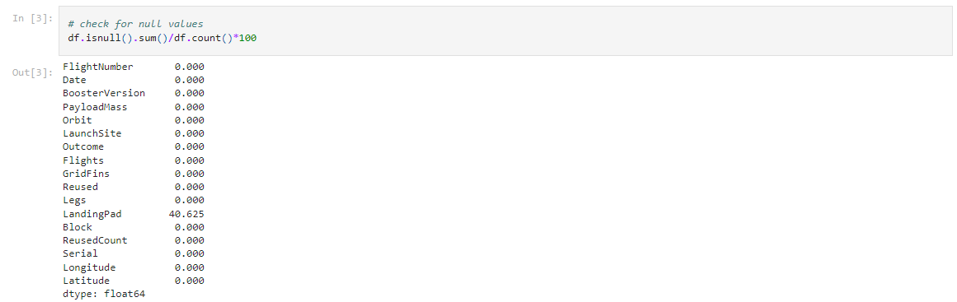
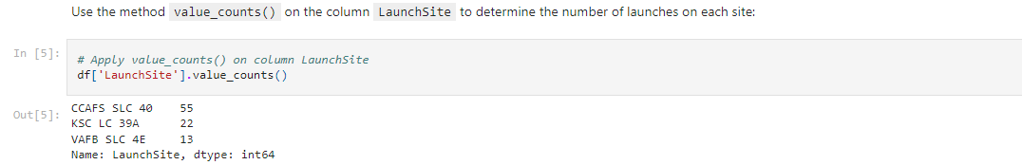
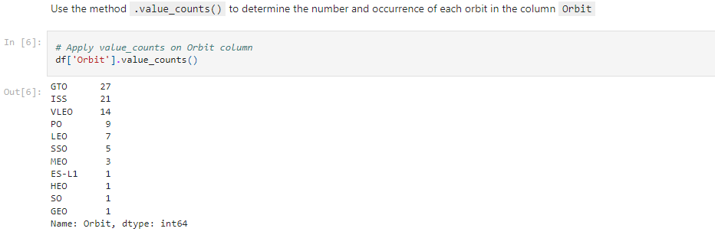
Data Wrangling
I performed exploratory data analysis and determined the training labels.
I calculated the number of launches at each site, and the number and occurrence of each orbits
The link to the notebook is https://github.com/amm2307/Capstone_Project/blob/master/EDA%20Lab.ipynb

Slide 11
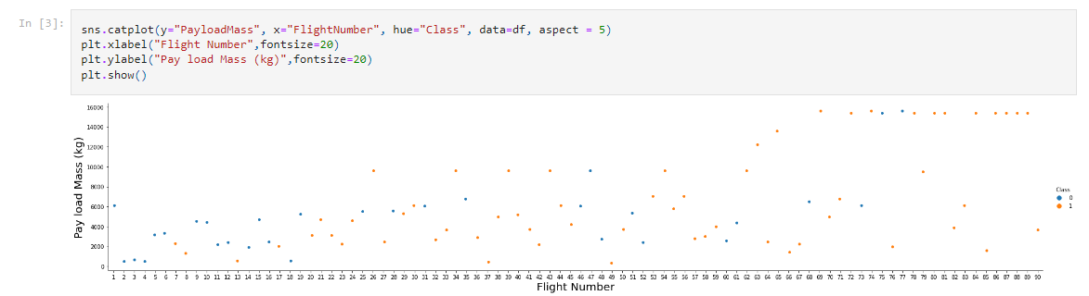
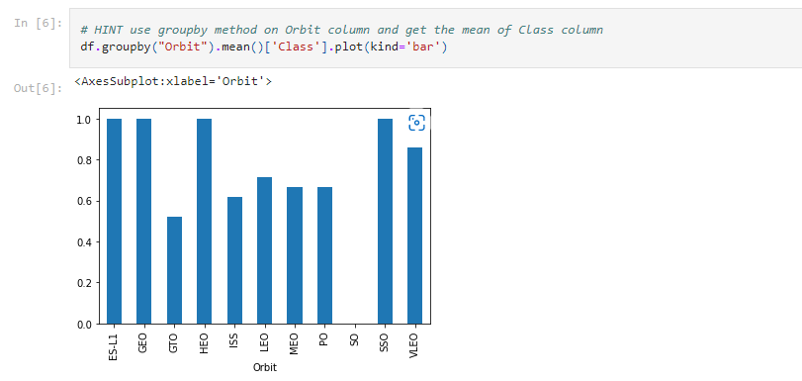
EDA with Data Visualization
I plot the FlightNumber vs PayloadMass and overlay the outcome of the launch and I plot the relationship between success rate of each orbit type.
The link to the notebook is https://github.com/amm2307/Capstone_Project/blob/master/EDA%20with%20Visualization%20Lab.ipynb

Slide 12
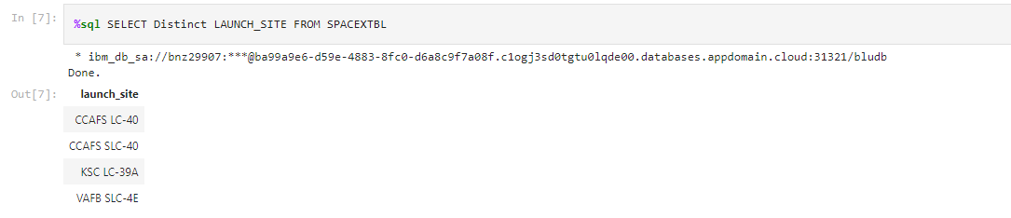
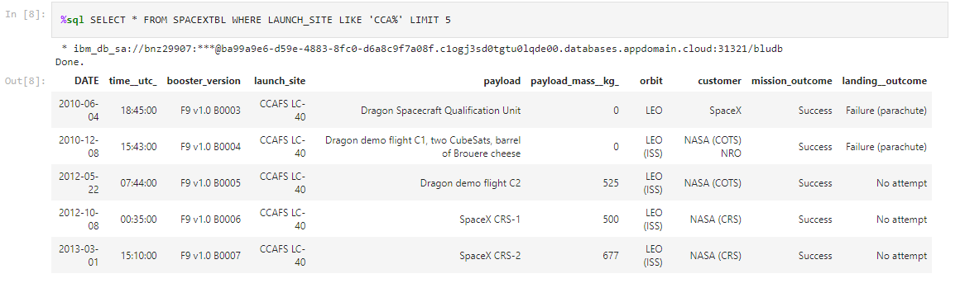
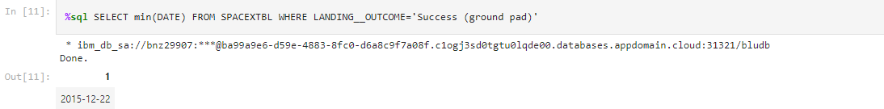
EDA with SQL
I display the names of the unique launch sites in the space mission.
I display 5 records where launch sites begin with the string 'KSC’.
I List the date where the first succesful landing outcome in drone ship was acheived.
The link to the notebook is https://github.com/amm2307/Capstone_Project/blob/master/EDA%20with%20SQL%20Lab.ipynb

Slide 13
Build an Interactive Map with Folium
I marked all launch sites, and I added map objects such as markers, circles, lines to mark the success or failure of launches for each site on the folium map.
I assigned the feature launch outcomes (failure or success) to class 0 and 1.i.e., 0 for failure, and 1 for success
Using the color-labeled marker clusters, I identified which launch sites have relatively high success rate.
I calculated the distances between a launch site to its proximities.
The link to the notebook is https://github.com/amm2307/Capstone_Project/blob/master/Interactive%20Visual%20Analytics%20with%20Folium%20lab.ipynb

Slide 14
Build a Dashboard with Plotly Dash
I built an interactive dashboard with Plotly dash
I plotted pie charts showing the total launches by a certain sites
I plotted scatter graph showing the relationship with Outcome and Payload Mass (Kg) for the different booster version.
The link to the notebook is

Slide 15
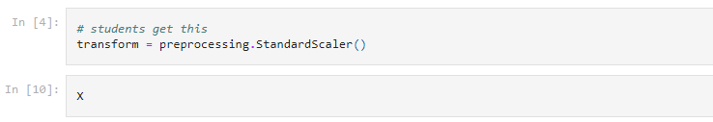
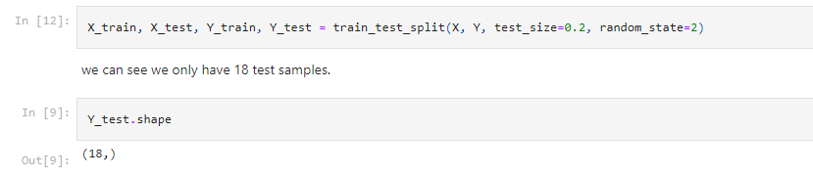
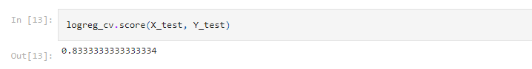
Predictive Analysis (Classification)
I loaded the data using numpy and pandas, transformed the data, split our data into training and testing.
I built different machine learning models and tune different hyperparameters using GridSearchCV.
I used accuracy as the metric for our model, improved the model using feature engineering and algorithm tuning.
The link to the notebook is https://github.com/amm2307/Capstone_Project/blob/master/Machine%20Learning%20Prediction%20lab.ipynb

Slide 16
Results
Exploratory data analysis results
Interactive analytics demo in screenshots
Predictive analysis results

Slide 17

Section 2

Slide 18
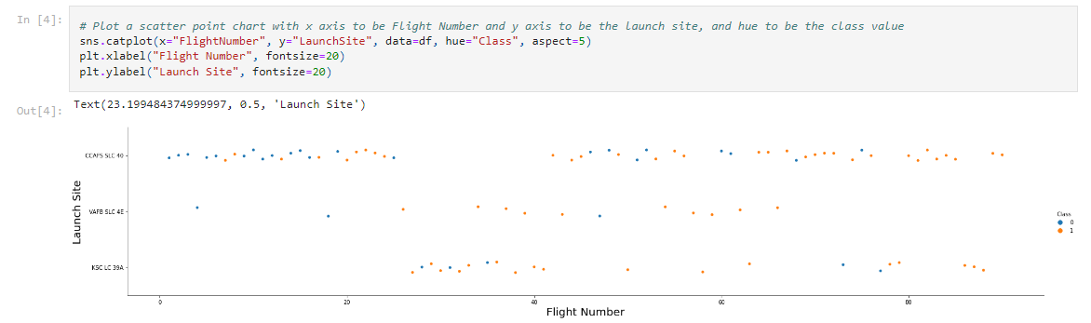
Flight Number vs. Launch Site
From the plot, we found that the larger the flight amount at a launch site, the greater the success rate at a launch site.

Slide 19
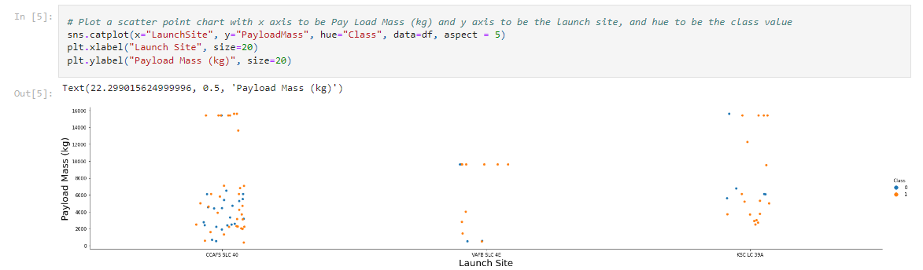
Payload vs. Launch Site
I find for the VAFB-SLC launchsite there are no rockets launched for heavypayload mass.

Slide 20
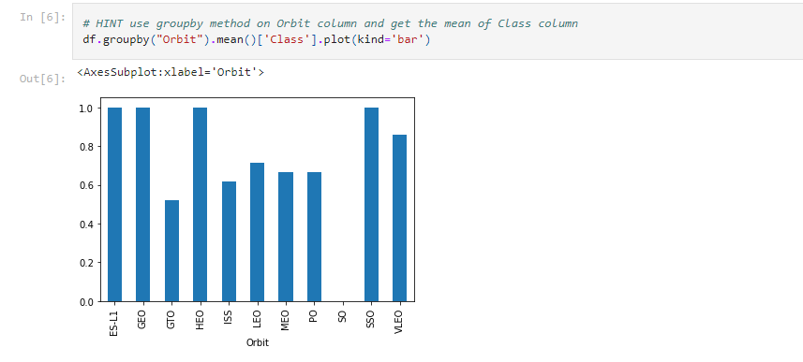
Success Rate vs. Orbit Type
From the plot, we can see that ES-L1, GEO, HEO, SSO, VLEO had the most success rate.

Slide 21
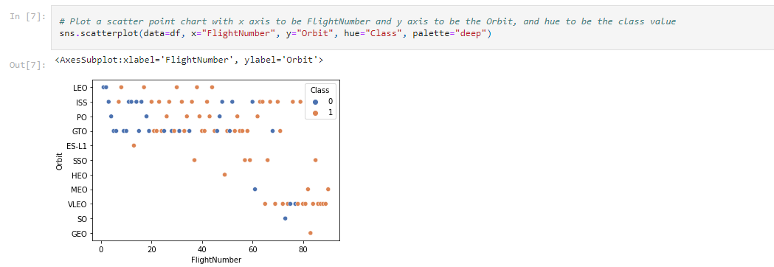
Flight Number vs. Orbit Type
The plot below shows the Flight Number vs. Orbit type. We observe that in the LEO orbit, success is related to the number of flights whereas in the GTO orbit, there is no relationship between flight number and the orbit.

Slide 22
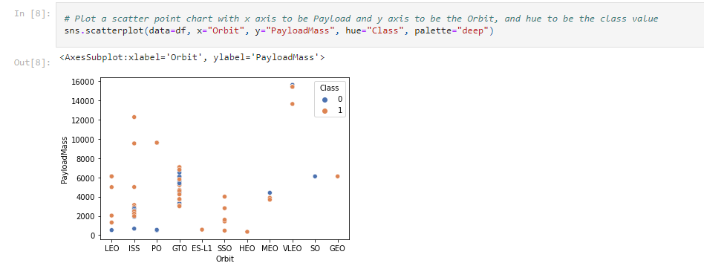
Payload vs. Orbit Type
I can observe that with heavy payloads, the successful landing are more for PO, LEO and ISS orbits.

Slide 23
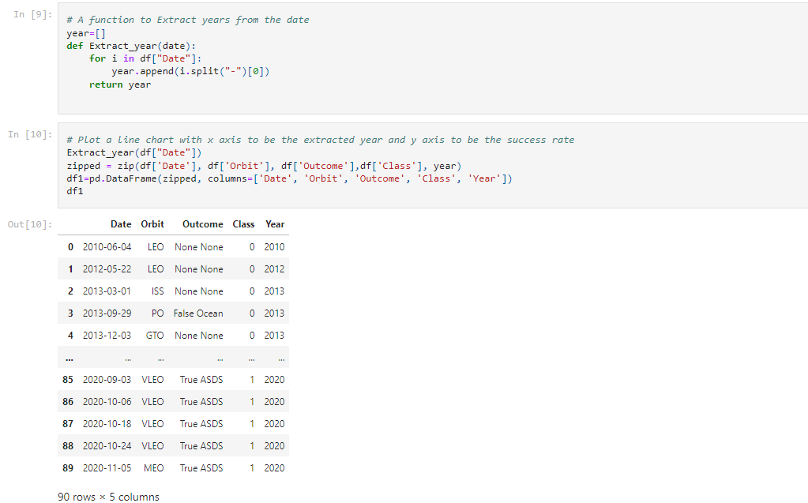
Launch Success Yearly Trend
I can observe that the sucess rate since 2013 kept increasing till 2020.

Slide 24
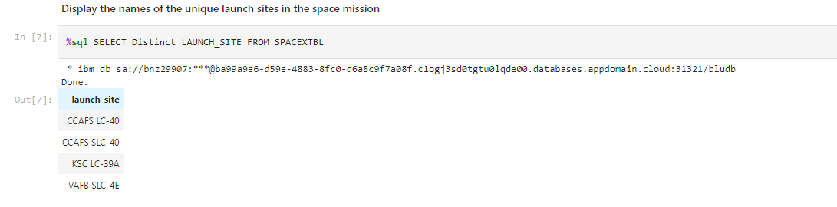
All Launch Site Names
I used the key word DISTINCT to show only unique launch sites from the SpaceX data.

Slide 25
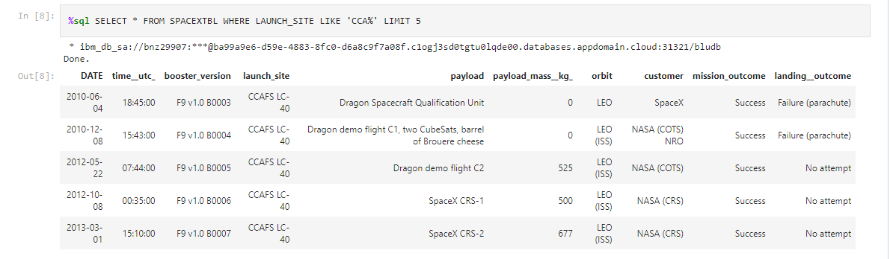
Launch Site Names Begin with 'KSC'
I Display 5 records where launch sites begin with the string 'KSC'

Slide 26
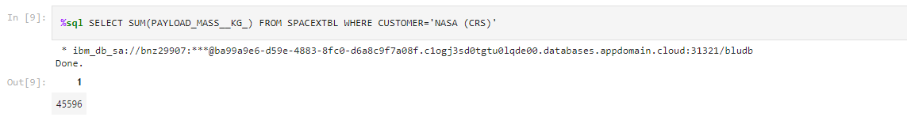
Total Payload Mass
I calculated the total payload carried by boosters from NASA as 45596 using the query below

Slide 27
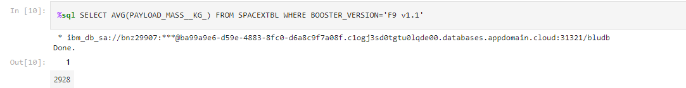
Average Payload Mass by F9 v1.1
I calculated the average payload mass carried by booster version F9 v1.1 as 2928

Slide 28
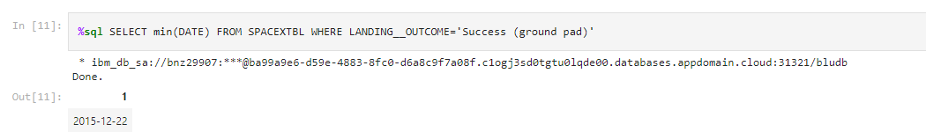
First Successful Ground Landing Date
I observed that the dates of the first successful landing outcome on ground pad was 22nd December 2015

Slide 29
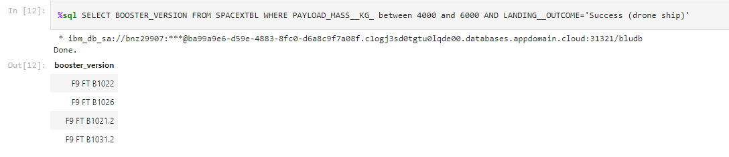
Successful Drone Ship Landing with Payload between 4000 and 6000
I used the WHERE clause to filter for boosters which have successfully landed on drone ship and applied the AND condition to determine successful landing with payload mass greater than 4000 but less than 6000

Slide 30
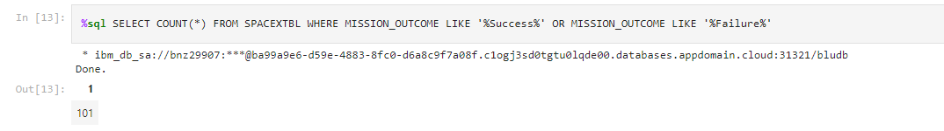
Total Number of Successful and Failure Mission Outcomes
I used wildcard like ‘%’ to filter for WHERE MissionOutcome was a success or a failure.

Slide 31
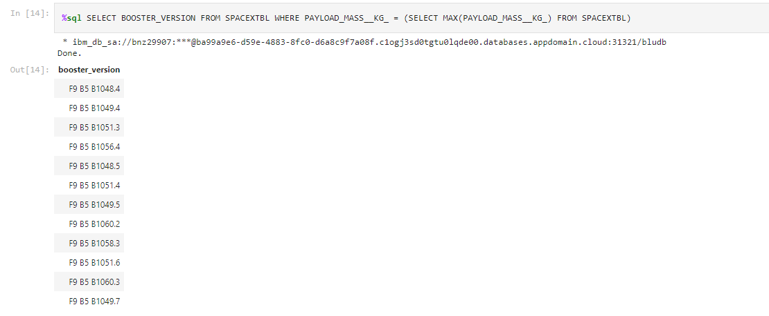
Boosters Carried Maximum Payload
I determined the booster that have carried the maximum payload using a subquery in the WHERE clause and the MAX() function.

Slide 32
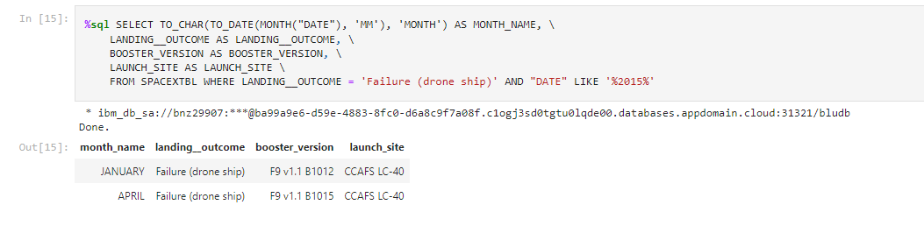
2015 Launch Records
I used a combinations of the WHERE clause, LIKE, AND, and BETWEEN conditions to filter for failed landing outcomes in drone ship, their booster versions, and launch site names for year 2015

Slide 33
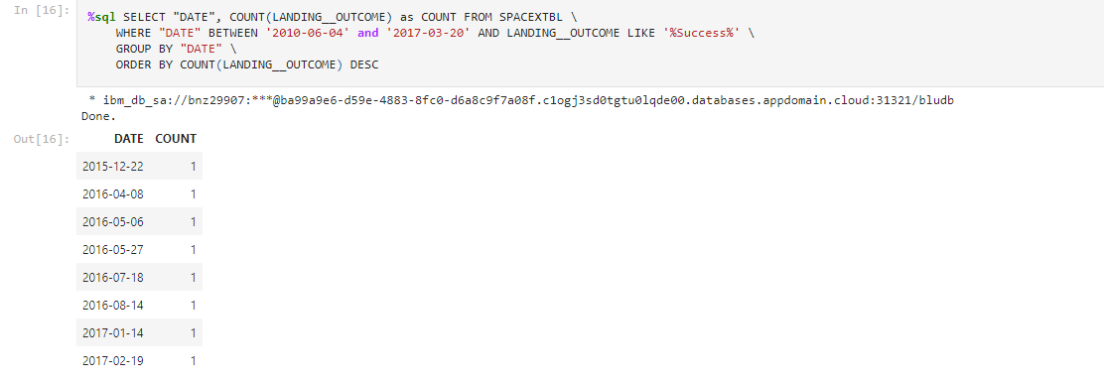
Rank Landing Outcomes Between 2010-06-04 and 2017-03-20
I selected Landing outcomes and the COUNT of landing outcomes from the data and used the WHERE clause to filter for landing outcomes BETWEEN 2010-06-04 to 2010-03-20.
I applied the GROUP BY clause to group the landing outcomes and the ORDER BY clause to order the grouped landing outcome in descending order.

Slide 34

Section 3

Slide 35
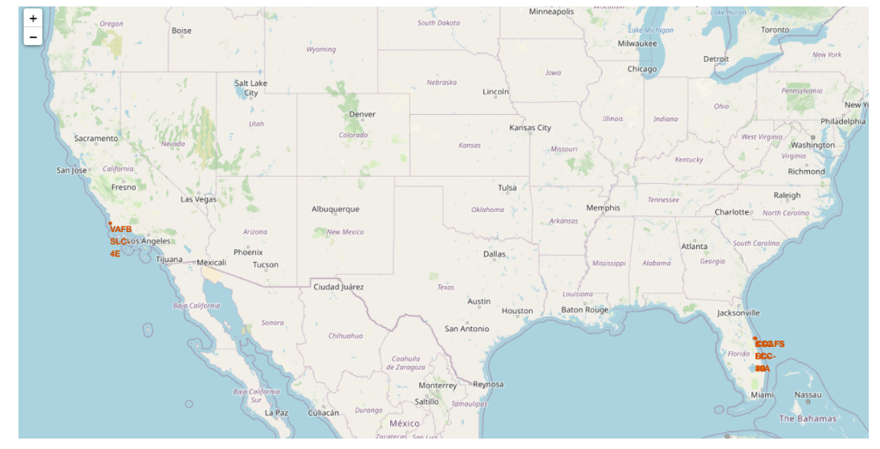
All launch sites global map markers
I can see that the SpaceX launch sites are in the United States of America coasts, Florida and California.

Slide 36
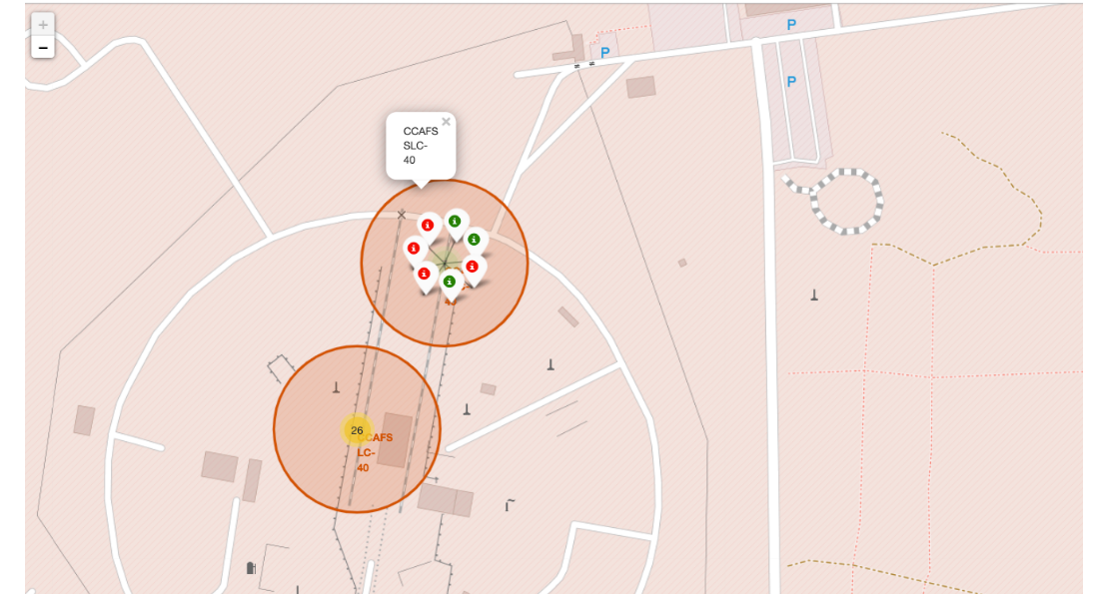
Markers showing launch sites with color labels
Green Marker shows successful Launches and Red Marker shows Failures.

Slide 37
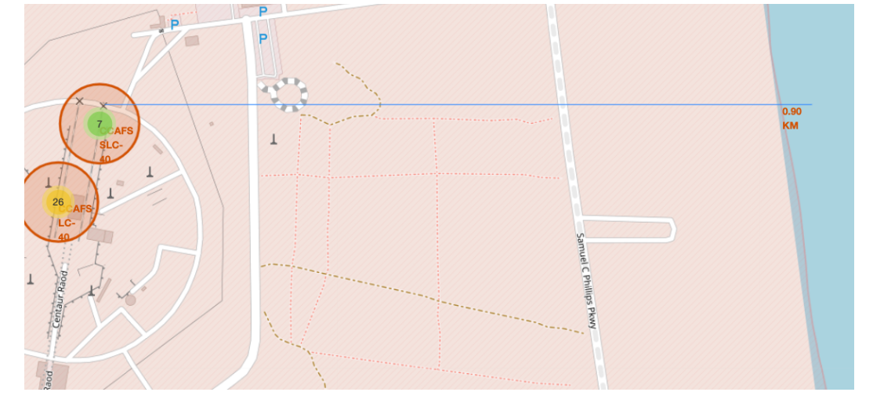
Launch Site distance to landmarks
Are launch sites in close proximity to railways? No.
Are launch sites in close proximity to highways? No.
Are launch sites in close proximity to coastline? Yes.
Do launch sites keep certain distance away from cities? Yes.

Slide 38

Section 4

Slide 39

Pie chart showing the success percentage achieved by each launch site

Slide 40

Pie chart showing the Launch site with the highest launch success ratio

Slide 41

Scatter plot of Payload vs Launch Outcome for all sites, with different payload selected in the range slider

Slide 42

Section 5

Slide 43
Classification Accuracy
The decision tree classifier is the model with the highest classification accuracy

Slide 44
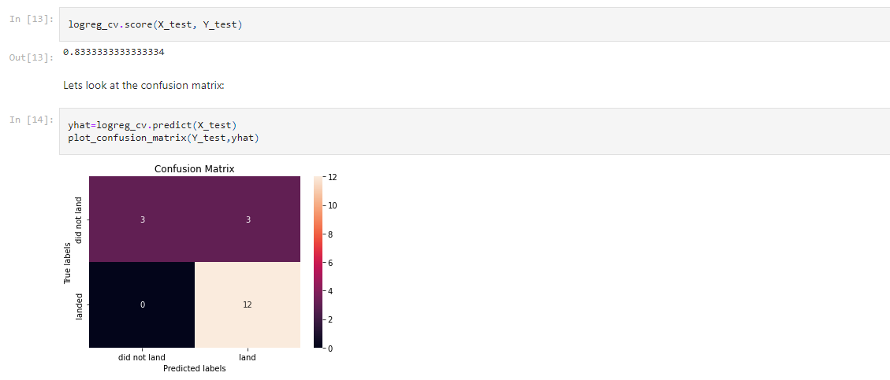
Confusion Matrix
The confusion matrix for the decision tree classifier shows that the classifier can distinguish between the different classes. The major problem is the false positives .i.e., unsuccessful landing marked as successful landing by the classifier.

Slide 45
Conclusions
I can conclude that:
Launch success rate started to increase in 2013 till 2020.
Orbits ES-L1, GEO, HEO, SSO, VLEO had the most success rate.
KSC LC-39A had the most successful launches of any sites.
The Decision tree classifier is the best machine learning algorithm.

Slide 46
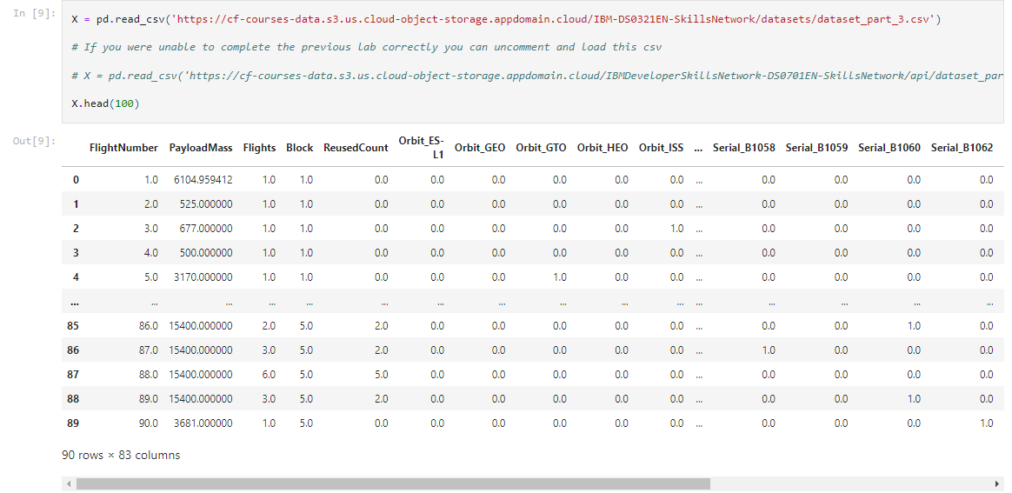
Appendix

Slide 47


